Slide 1

FIFA Project

Slide 2

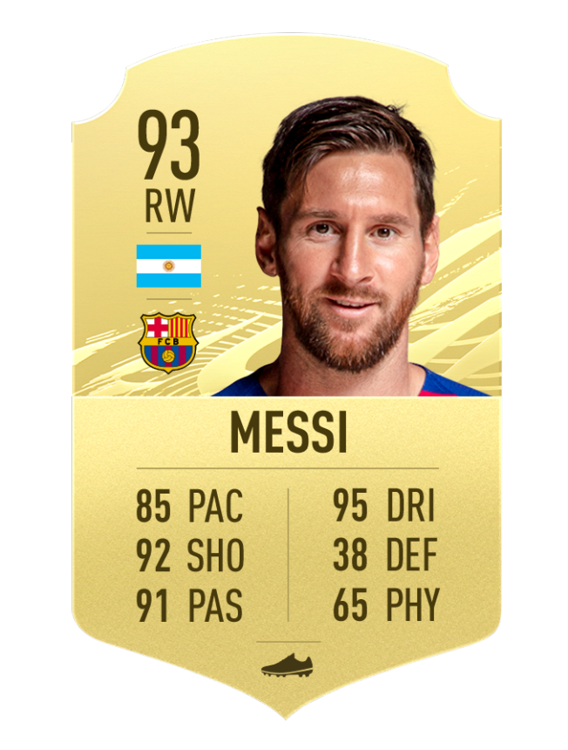
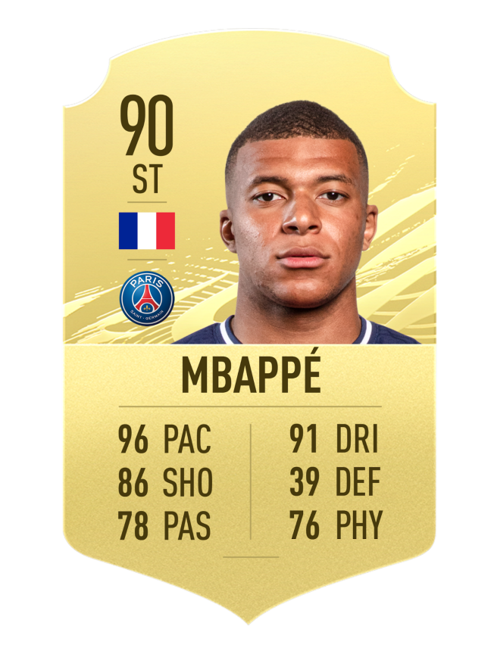
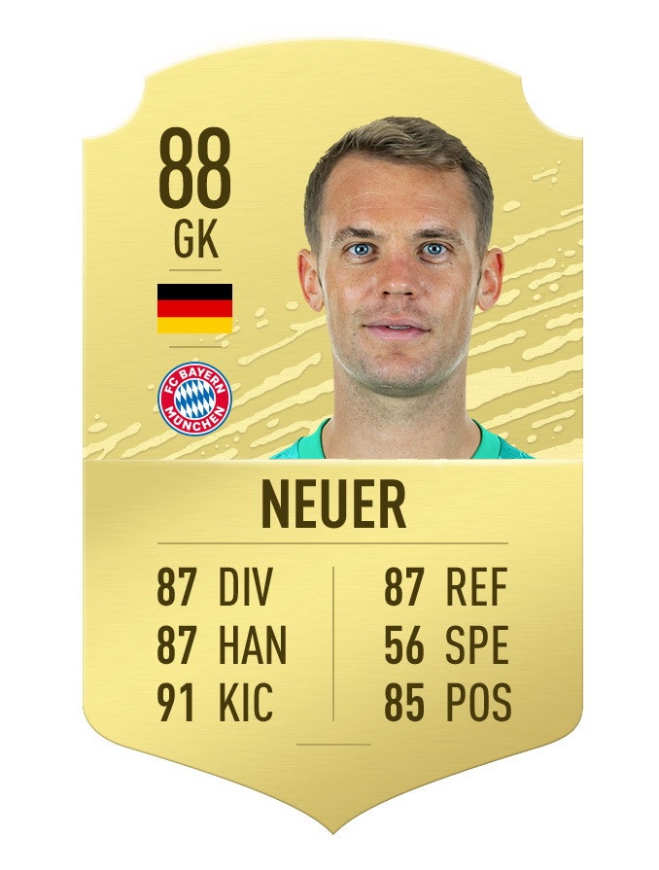
Mission and feature descriptions
The mission: predict the value/wage of FIFA’s players.

Slide 3
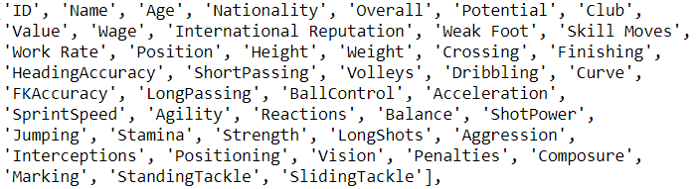
Meet the features
Identification
Y

Slide 4
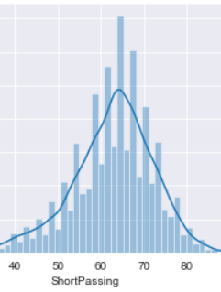
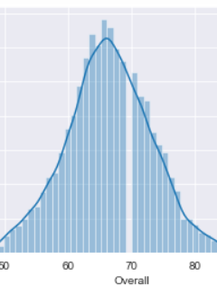
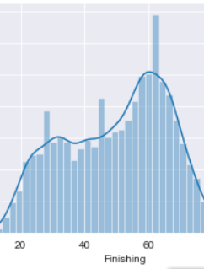
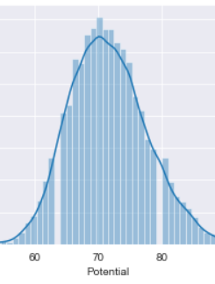
Feature statistics and feature selection

Slide 5
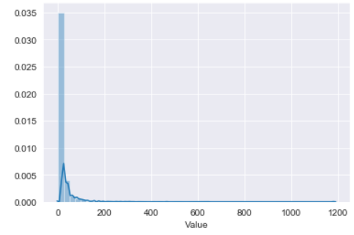
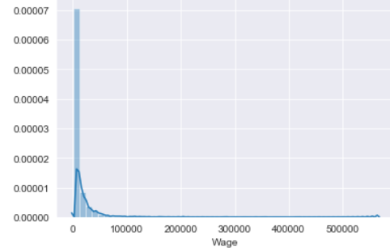
Wage and Value

Slide 6
Preprocessing
Data organization and feature selection
Treatment of categorical and object variables
Dummy variables
One hot encoding
Features normalized

Slide 7
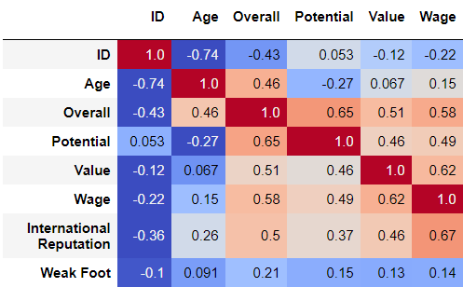
Feature correlation matrix

Slide 8
Hyperparameters tuning
number of neurons: L1=128, L2=128, L3=1
number of layers: 3
regularization: L1/L2/Dropout

Slide 9
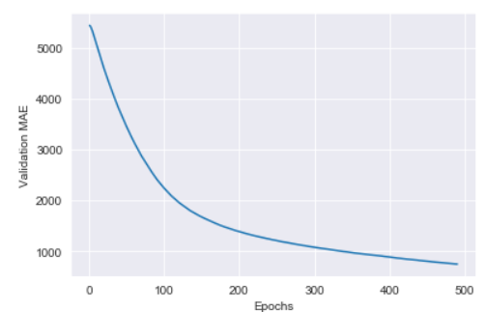
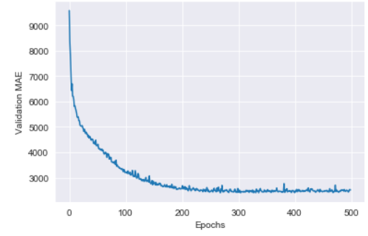
Wage

Slide 10
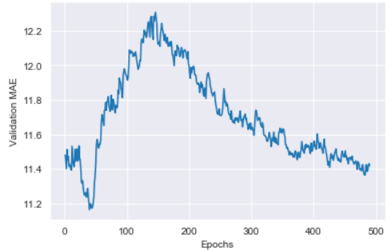
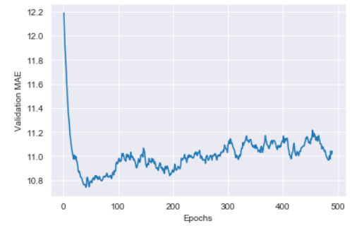
Value

Slide 11



Results analysis
Training, validation and Test results.

Slide 12





